Slide 1
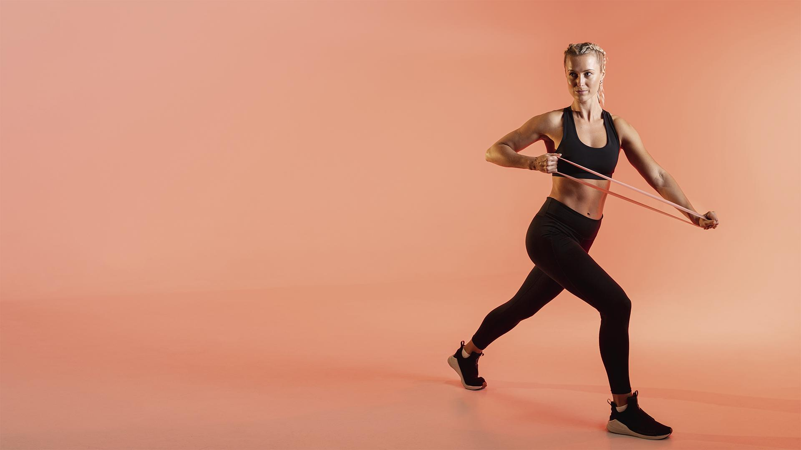
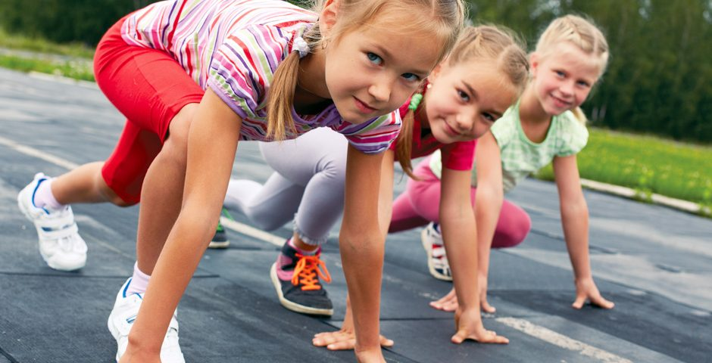
FITNESS APP
Motoric skills development
Made by:
Lisa Dumaij 19049838
Yuliya Litvin 20161417
Mustafa Mousa 18068987
Pascal Seegers 21132844
Joost van Viegen 18048757
Joep van der Zanden 19134282
Here is where your pitch deck begins

Slide 2
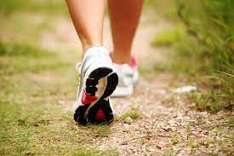
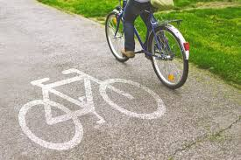
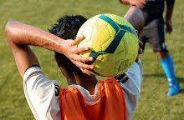
Gross Motoric Skills

Slide 3
Gross Motoric Skills

Slide 4
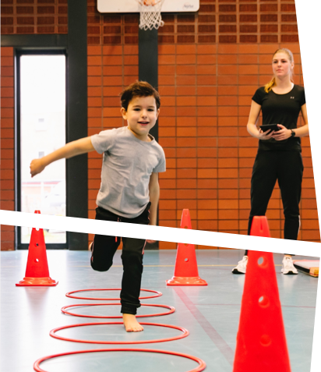
StartVaardig
01
Started in 2019
Providing tools
Value of motoric skills

Slide 5
Measurements and tests
Competence
Motivation
Perception
BMI
Questionaires

Slide 6
02 Our Goal
“A model to predict potential motoric disadvantage”
Klikken om tekst toe te voegen

Slide 7
03 What did we do
Received data
Combined data files
Explored data using visualisations
Predictions of MQ score with KNN
Notes:
We have received the T0 data, but we are still waiting for the T1.
The data files we received have been combined into a single file.
We have explored the data using multiple visualisations

Slide 8
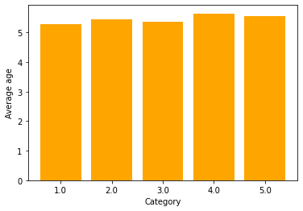
Notes:
The first of these we would like to show you is the distribution of the average age per MQ score category.

Slide 9
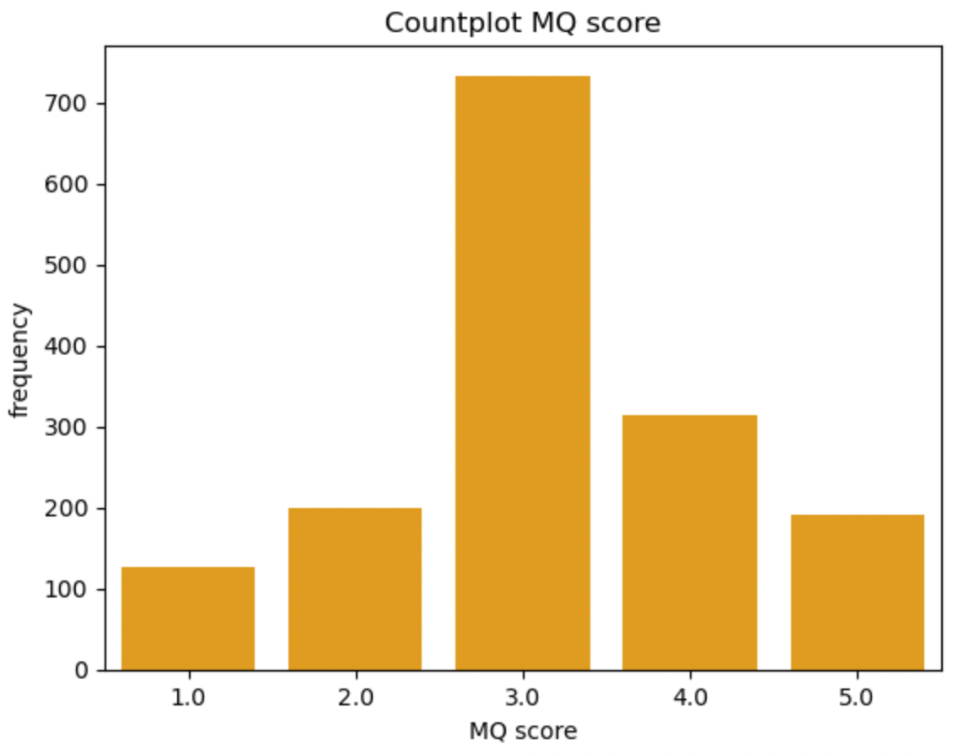
Notes:
The second one we would like to show you is the frequencey of MQ score categories in our dataset. We can clearly see that an MQ score category of 3 is the most common one.

Slide 10
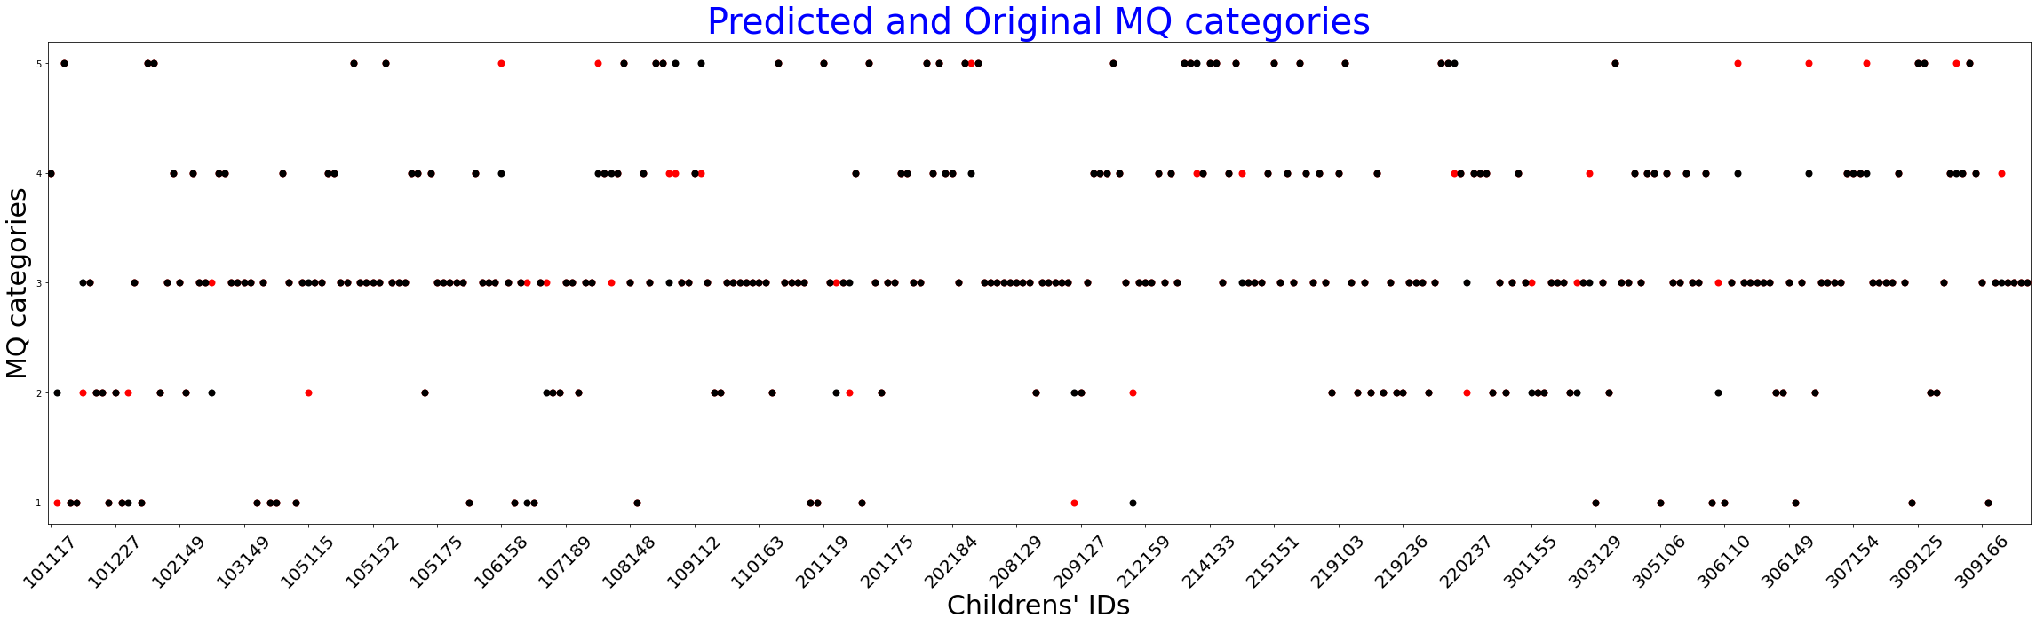
Notes:
The first of these we would like to show you is the distribution of the average age per MQ score category.

Slide 11
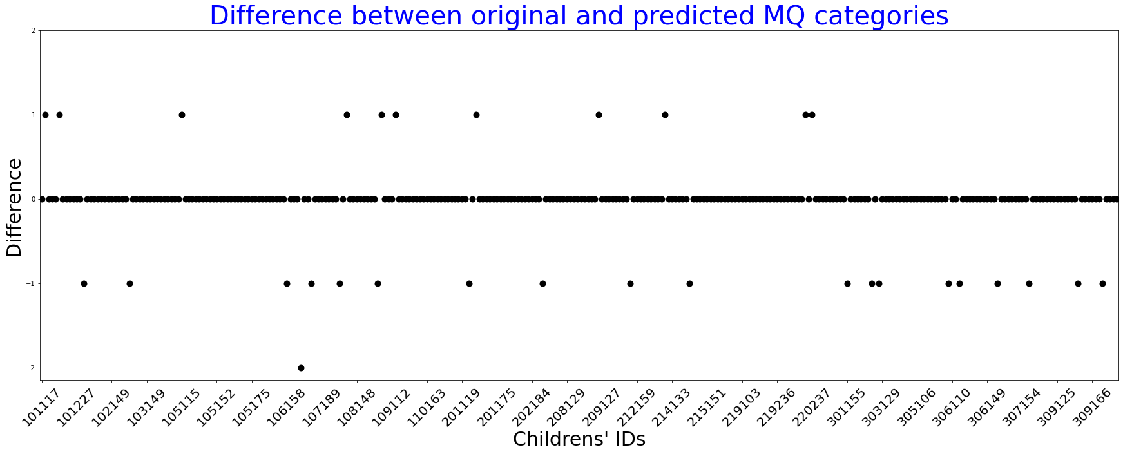
Notes:
The first of these we would like to show you is the distribution of the average age per MQ score category.

Slide 12
04 Next Steps
Receive Data
Explore data
Create models
Write paper
T0 has been received, T1 is coming
Notes:
I would now like to tell you about our next steps:
We have already received part of the data, the other half is coming.
The data we already have has been visualised in multiple plots in order to explore it.

Slide 13
THANK YOU!
Do you have any questions?
Lisa Dumaij
19049838@student.hhs.nl

